Slide 1
An Introduction to Network Analyzers (Wireshark)
By: Pavlos Antoniou
Spring 2008
* The material is taken from J.F. Kurose & K.W. Ross, “Computer Networking: A Top-Down Approach Featuring the Internet”, 4rd Edition.

Slide 2


Network Analysis and Sniffing
Currently data just travels around your network like a train. With a packet sniffer, get the ability to capture the data and look inside the packets to see what is actually moving along the tracks.
Process of capturing, decoding, and analyzing network traffic
  Why is the network slow
  What is the network traffic pattern
  How is the traffic being shared between nodes
Known as traffic analysis, protocol analysis, sniffing, packet analysis, eavesdropping*, etc.
CS420: High Speed Multimedia and Multiservice Networks
*Listen secretly to what is said in private!

Slide 3
Network Analyzer
A combination of hardware and software tools what can detect, decode, and manipulate traffic on the network
  Passive monitoring (detection) - Difficult to detect
  Active (attack)
Available both free and commercially
Mainly software-based (utilizing OS and NIC)
Also known as sniffer
  A program that monitors the data traveling through the network passively
  Receives a copy of packets that are sent/received from/by applications and protocols running on your machine
Common network analyzers
  Wireshark
  Ethereal
  Windump
  And much more….

Slide 4
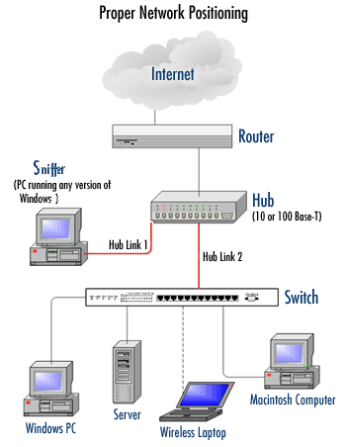
Sniffer Positioning

Slide 5
Who Uses Network Analyzers
System administrators
  Understand system problems and performance
  Intrusion detection
Malicious individuals (intruders)
  Capture cleartext data
  Passively collect data on vulnerable protocols
    FTP, POP3, IMAP, SMATP, rlogin, HTTP, etc.
    Capture VoIP data
  Mapping the target network
  Traffic pattern discovery
  Actively break into the network (backdoor techniques)

Slide 6
What is Wireshark?
Formerly called Ethereal
An open source packet analyzer
  free with many features
Decodes over 750 protocols
Compatible with many other sniffers
Plenty of online resources are available
Supports command-line and GUI interfaces
  TSHARK (offers command line interface) has three components
    Editcap
    Mergecap
    text2pcap
Remember: You must have a good understanding of the network before you use Sniffers effectively!

Slide 7
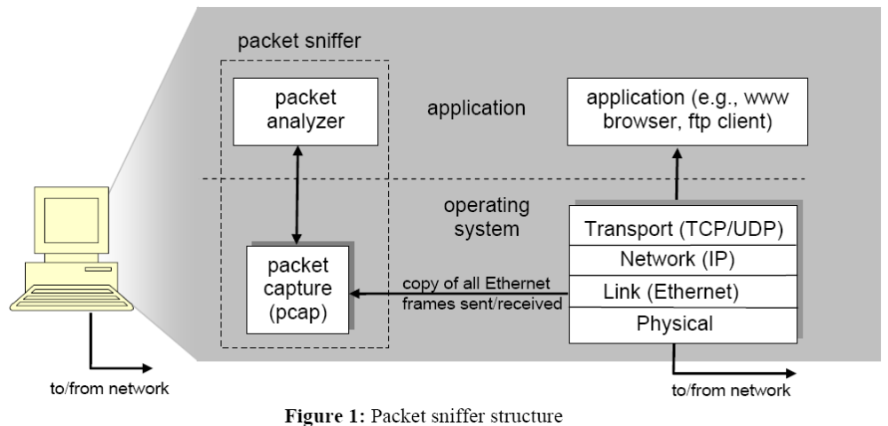
Wireshark (and WinPcap)
Wireshark – Application for Sniffing Packets
WinPcap – open source library for packet capture
Operating System – Windows & Unix/Linux
Network Card Drivers – Ethernet/WiFi Card
Ethernet Card

Slide 8
Getting Wireshark
Download the program from
  www.wireshark.org/download.html
Requires to install capture drivers (monitor ports and capture all traveling packets)
  Windows: winpcap (www.winpcap.org)
  Linux: libpcap

Slide 9
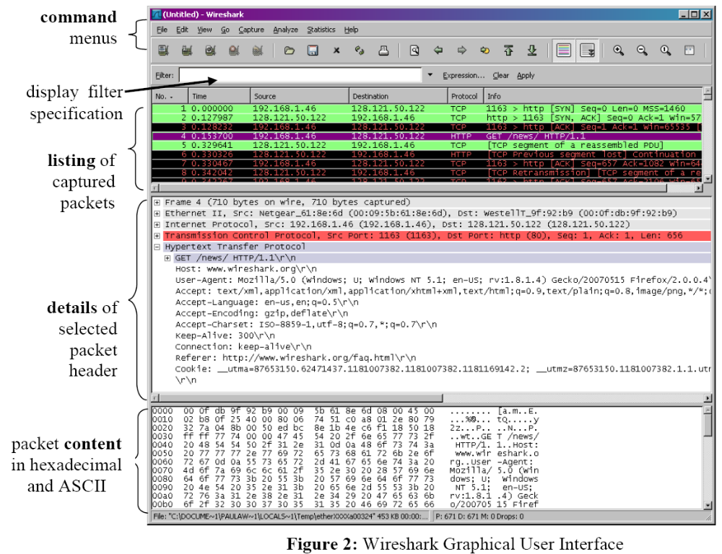
Running Wireshark

Slide 10
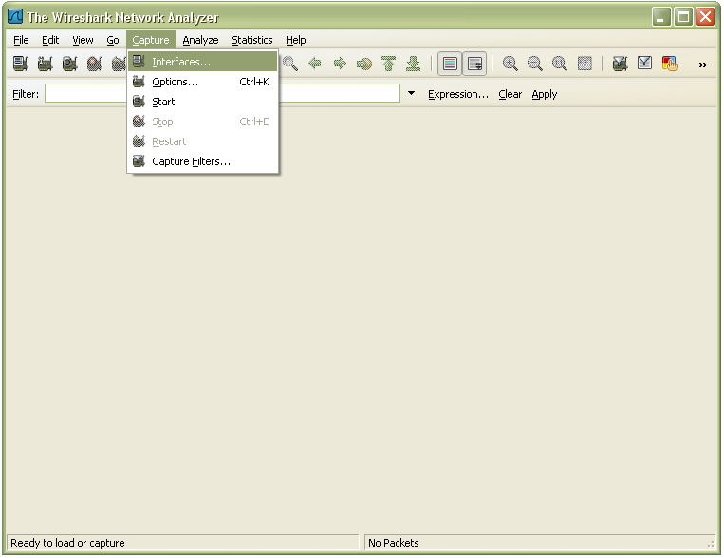
Running Wireshark (cnt’d)

Slide 11
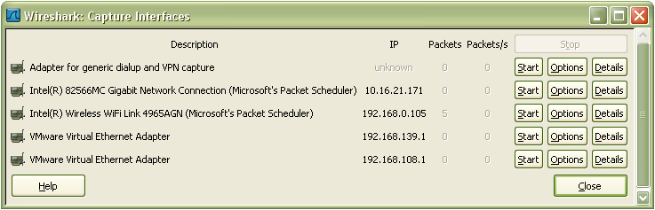
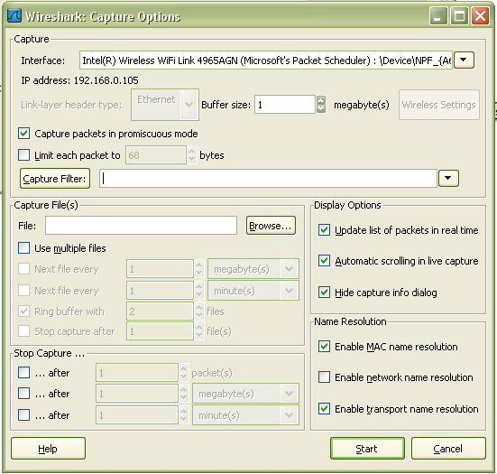
Running Wireshark (cnt’d)
Choose a network interface card
Sniffing parameters on the
selected network interface card

Slide 12
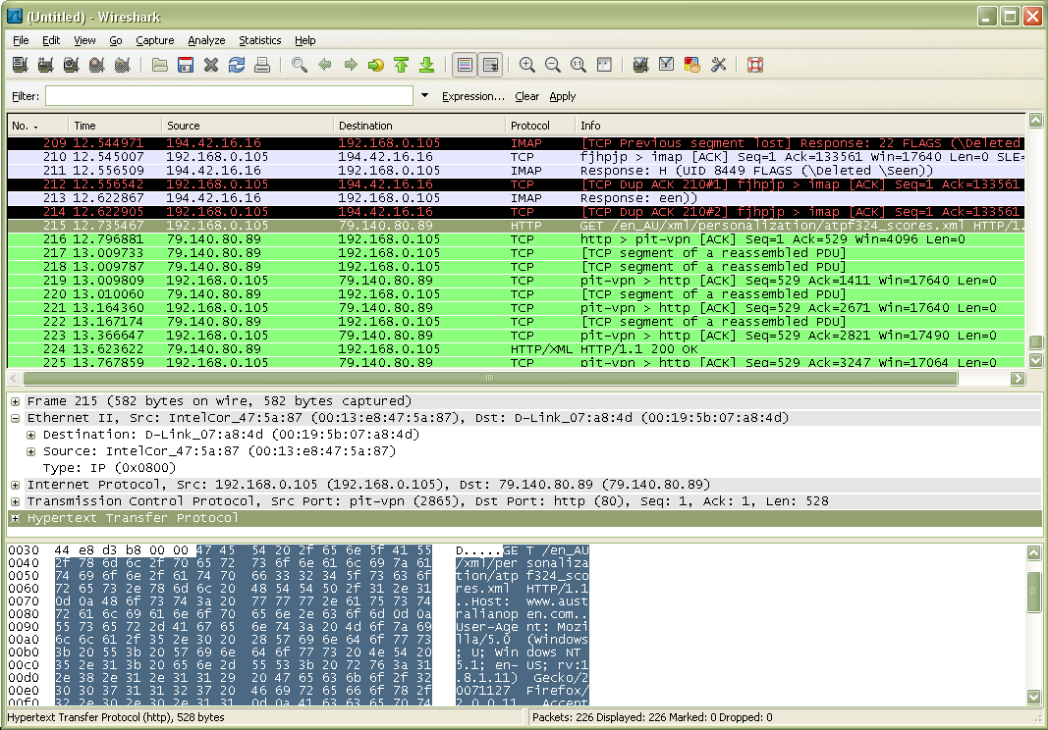
Packet #215: HTTP packet
Details of the selected packet (#215)
Raw data (content of packet # 215)

Slide 13
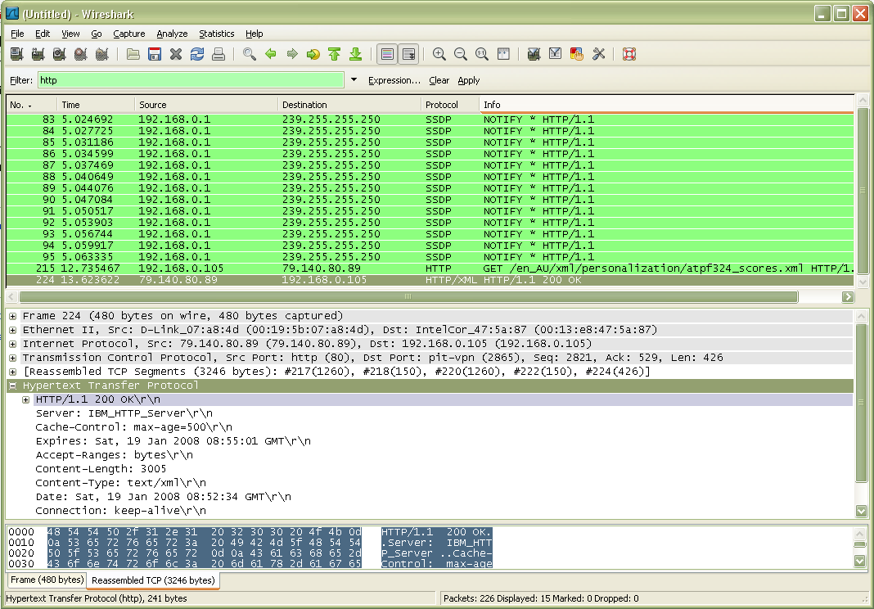
Filtering HTTP packets only

